Slide 1
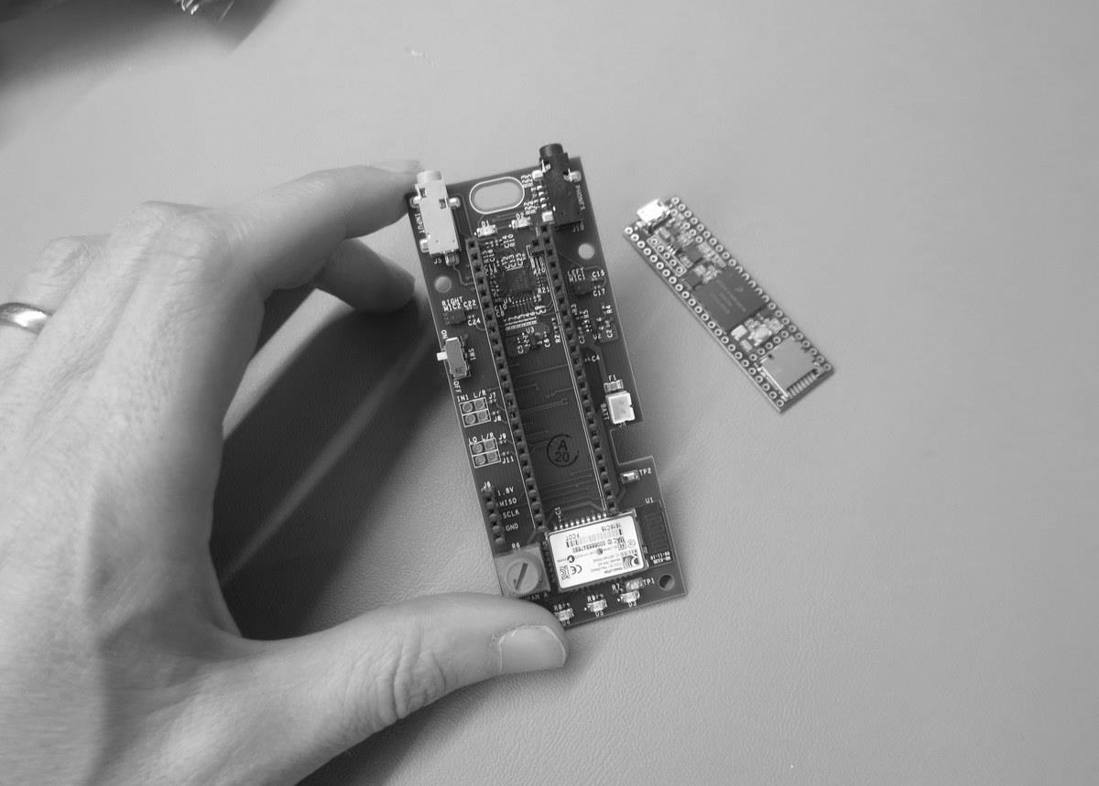
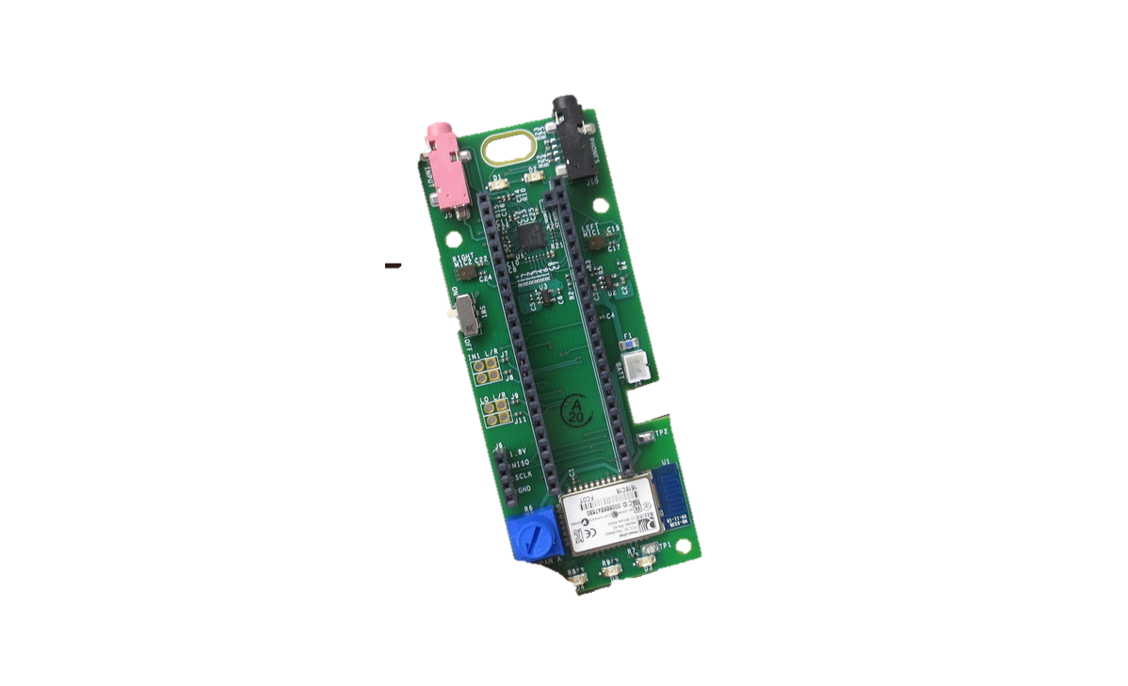
Tympan
Audio Interface

Slide 2
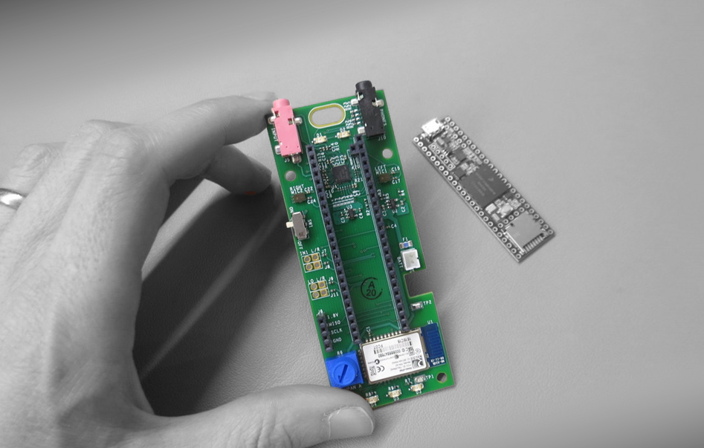
Tympan
Audio Interface
TI AIC3206
Teensy
3.5/3.6
Measuring
Self-Noise

Slide 3
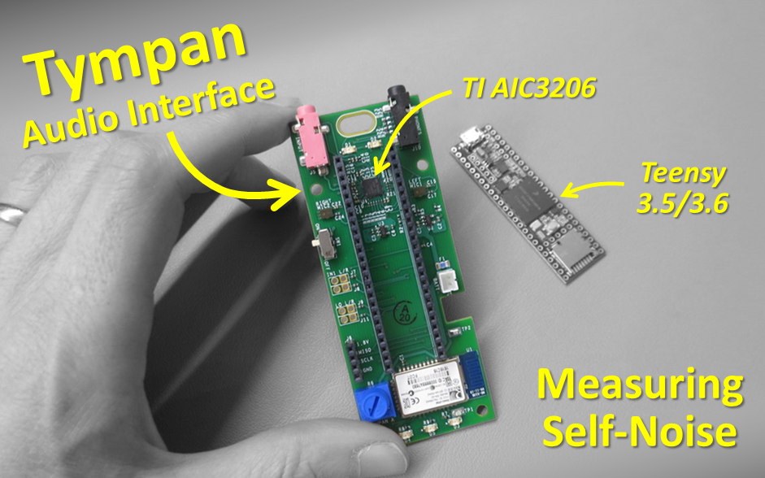

Slide 4
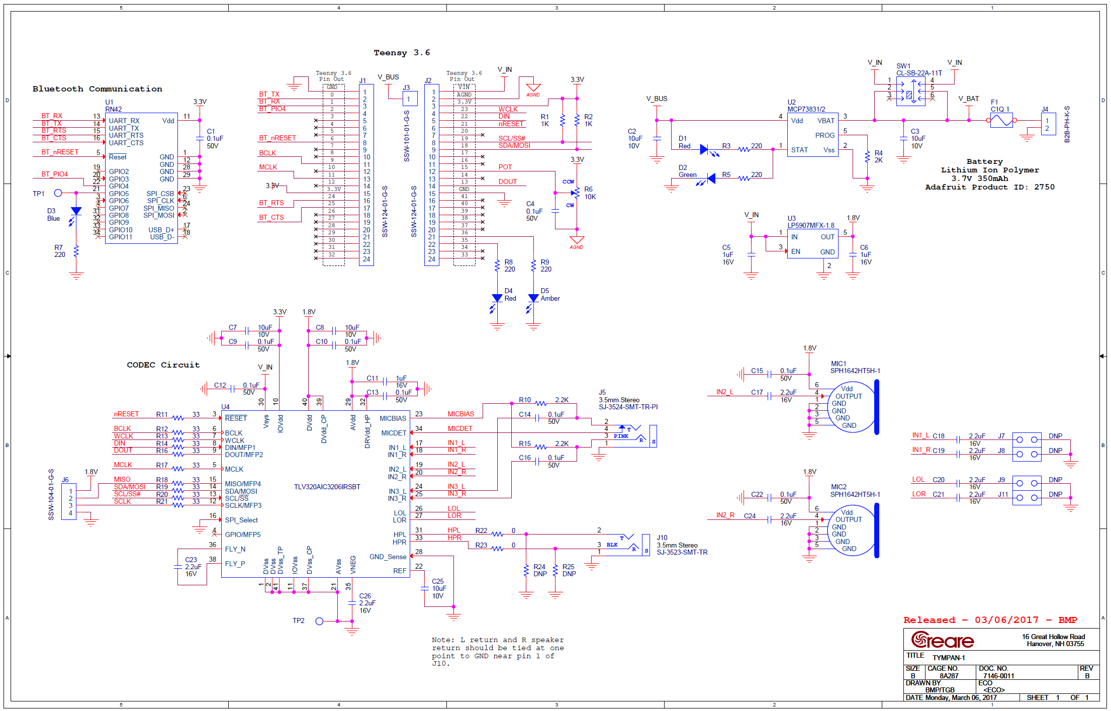

Slide 5
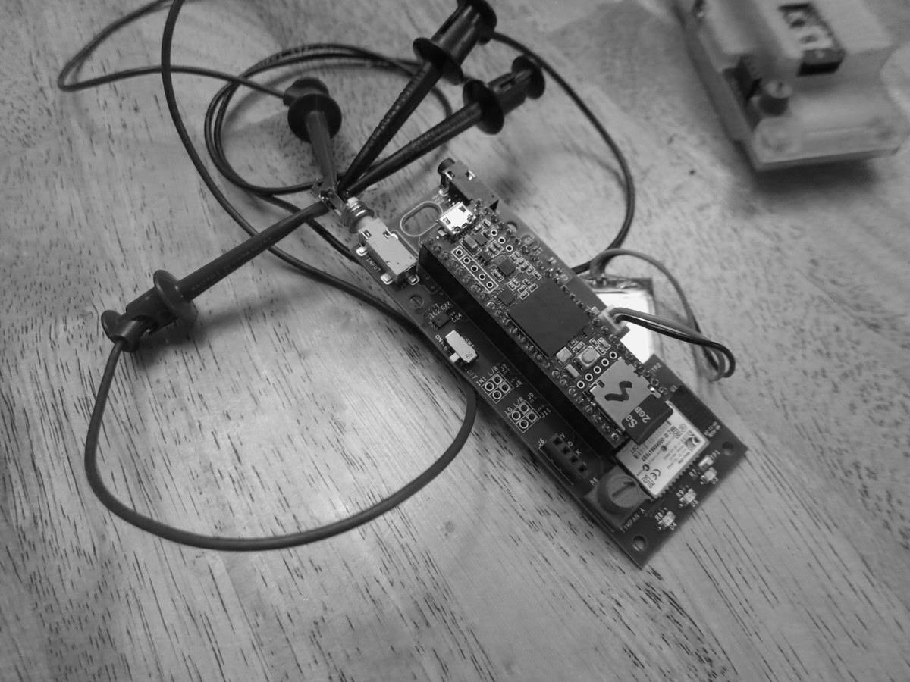
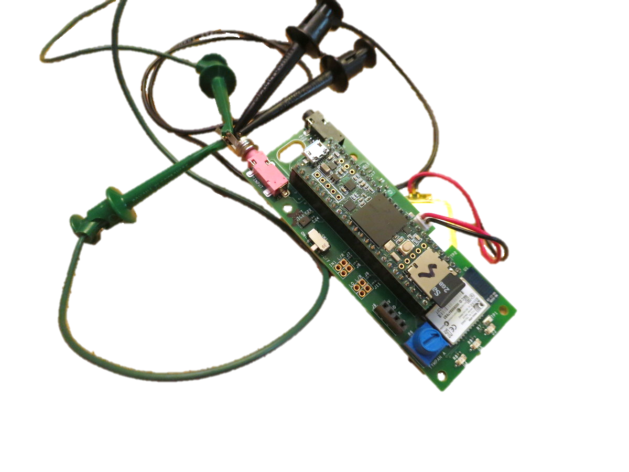

Slide 6
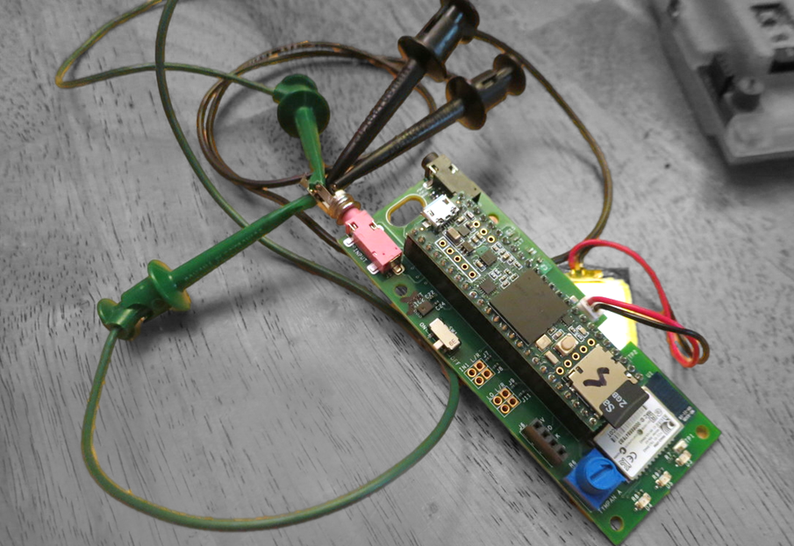
Shorting the
Inputs

Slide 8
Lower is Better
Higher is Better

